Slide 1
BI Unit IV- Part 1
Topic: Data Mining, its Properties and Tasks
Presented by: Drashti Shrimal1 Topic: Data Mining, its Properties and Tasks

Slide 2
Topic:
Data Mining
Properties
Tasks
Examples

Slide 3
What is Data Mining
Data mining refers to extracting or mining knowledge from large amounts of data.
The term is actually a misnomer. Thus, data mining should have been more appropriately named as knowledge mining which emphasizes on mining from large amounts of data and transform it into an understandable structure for further use.

Slide 4
What is Data Mining
It is the computational process of discovering patterns in large data sets involving methods at the intersection of artificial intelligence, machine learning, statistics, and database systems.
The overall goal of the data mining process is to extract information from a data set and transform it into an understandable structure for further use.

Slide 5
Key Properties of Data Mining
The key properties of data mining are:
Automatic discovery of patterns
Prediction of likely outcomes
Creation of actionable information
Focus on large datasets and databases

Slide 6
Tasks of Data Mining
Data mining involves six common classes of tasks:
1. Anomaly detection (Outlier/change/deviation detection) – The identification of unusual data records, that might be interesting or data errors that require further investigation.
2. Summarization – providing a more compact representation of the data set, including visualization and report generation.

Slide 7
Tasks of Data Mining
3. Association rule mining(Dependency modelling) – Searches for relationships between variables. For example market basket analysis.
4. Clustering – is the task of discovering groups and structures in the data that are in some way or another "similar", without using known structures in the data.

Slide 8
Tasks of Data Mining
5. Classification – is the task of generalizing known structure to apply to new data. For example, an e-mail program might attempt to classify an e-mail as "legitimate" or as "spam".
6. Regression – attempts to find a function which models the data with the least error.

Slide 9
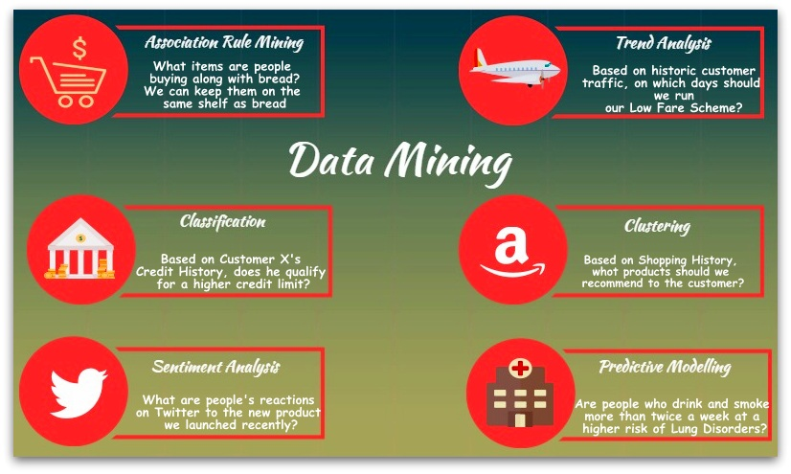
Examples of Data Mining

